Slide 1
Experimentation using full supply
For CTB and material gating
Ken
Apr 2020

Slide 2
Purpose
Experimenting to use
Full Horizon PCBA SCR
for
E2E views on Build projection and Material impacts.

Slide 3
High Level Process and Outcome
PCBA SCR allocated to specific DF
(E2E supply view)
DF supply for specific DF
DF capacity
Expected outcomes
More accurate and E2E data views by using full SCR;
Reduce dependancy on CM;
Productivity gain.
CTB for each PO/SS
Sort customer SS/PO into a “production” sequence
Allocate supply&capacity to each PO
Material shortage
qty/$impact for each PO/SS

Slide 4
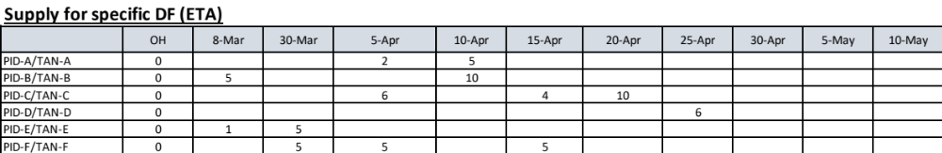
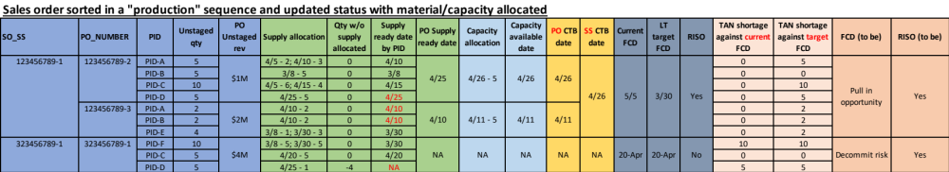
Example – Allocate supply/capacity and generate PO/SS CTB
Based on this we can summarize the E2E CTB, shortages qty/$impact and RISO (next page)…

Slide 5
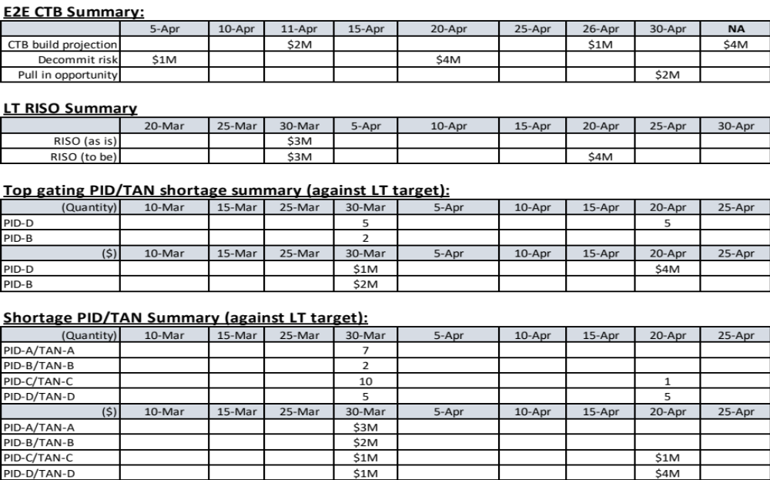
(continued) Aggregated Summaries (examples)
Refer to real output for the latest

Slide 6
Main WorkFlow
3A4 backlog processings
Start
Read data
(3A4, PCBA supply, DF supply, BOM, CT2R, capacity,exception)
Add exception into 3A4
Sort/Rank 3A4 SS/PO into a “production” sequence
Calculate PO ,SS CTB date and identify top gating
Update SS status (RISO to be, pull in/decommit)
Convert SCR supply to ETA based
Recover DF supply after CT2R
Add BOM PN into 3A4
Allocate capacity to each PO in sequence
Identify gating/non-gating materials and impact
Change PN to versionless (PCBA/DF supply, BOM, CT2R)
Exclude CT2R<5days PN from DF supply
Allocate PCBA/DF supply to each PO in sequence
Calculate supply ready date (PN level, PO level) and shortages
Make different kind of summaries
End
Note: only consider PN provided in the supply input; others considered as no need to consider.

Slide 7
3A4 Order Ranking Logic (new logic)
PR1/2/3
(Rank# 1/2/3)
Current FCD
L4/BUP/YE
(Rank# 4/5/6)
OSSD
Order qty
Rev/non-rev
Including DPAS
Prioritize smaller qty order
Prioritize rev order
Manual exceptional priority injection by DFPM
Note:
Ranking logic aligns with the central priority guidelines and DF operations
Site should actively manage the RISO and pull in orders when possible (especially for L4/BUP/YE/Ageing/Recommit orders)
DFPM can also set exceptional priority through smartsheet which will be captured and considered in the ranking
Orders with MFG_HOLD have lowest priorities among all

Slide 8
3A4 Backlog Processings
Cancelled orders and packed orders kept in report, but removed in creating the blg dict
Redefine the addressable flag
Calculate earliest_packable_date based on target SSD, LT target FCD and other exceptions
Create ‘min_date’ col based on OSSD and LT target FCD
Calculate SS revenue and SS unstaged, as well revenue by unit; rank SS by unit revenue
Process the top categories and rank
Rank the overall SS based on sorting criterias (process: Rank 3A4 SS/PO)

Slide 9
Calculate PO CTB/ SS CTB
PO CTB:
FLT using 3 currently
PO without supply coverage or with MFG_HOLD having CTB 180days out (ITF)
CTB in the past will be changed to today
CTB also consider earliest_packable_date which followed below logic:
  Unscheduled orders packable date 14days out from today;
  MFG_HOLD orders packable date 180days out from today;
  Exception orders packable date 14days out from today;
  Normal order : addressable logic for based on target SSD and LT target FCD
  Note: scheduled but missing target dates does not generate this date (may need a fix)

Slide 10
Summaries
Build projection
Based on po_ctb date
Using C_UNSTAGED_DOLLARS
Order status summary
Based on ss_updated_status generated from ss_ctb
Based on current FCD date (unscheduled orders will not show up in the summary)
Using C_UNSTAGED_DOLLARS
RISO status summary
Based on RISO(as is) and RISO(to be)
Using ss_unstg_rev
Build impact summaries
Based on tan_supply_ready_date instead of po_ctb
tan_supply_ready_date cut off is Thursday of of each cut off week
Have different cut offs: wk0 – current week, wk1/2/3…. And qend (backlog is based on “addressable” backlog based on specific week cutoff)

